Slide 1

One & Only Integrated Master Plan
With Balinese philosophy of Tri Hita Karana, Three Way of Happiness
TRI HITA KARANA

Slide 2
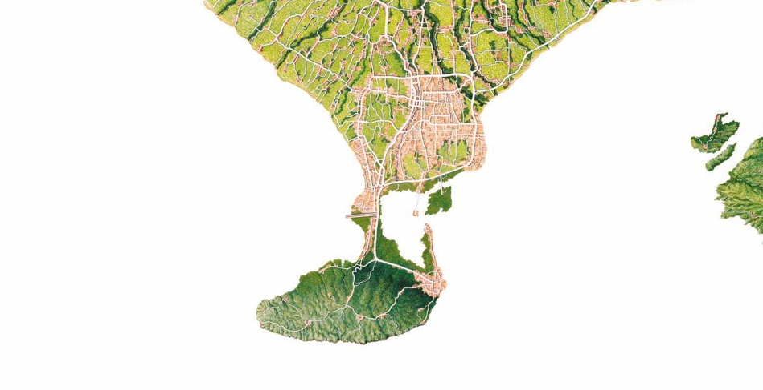

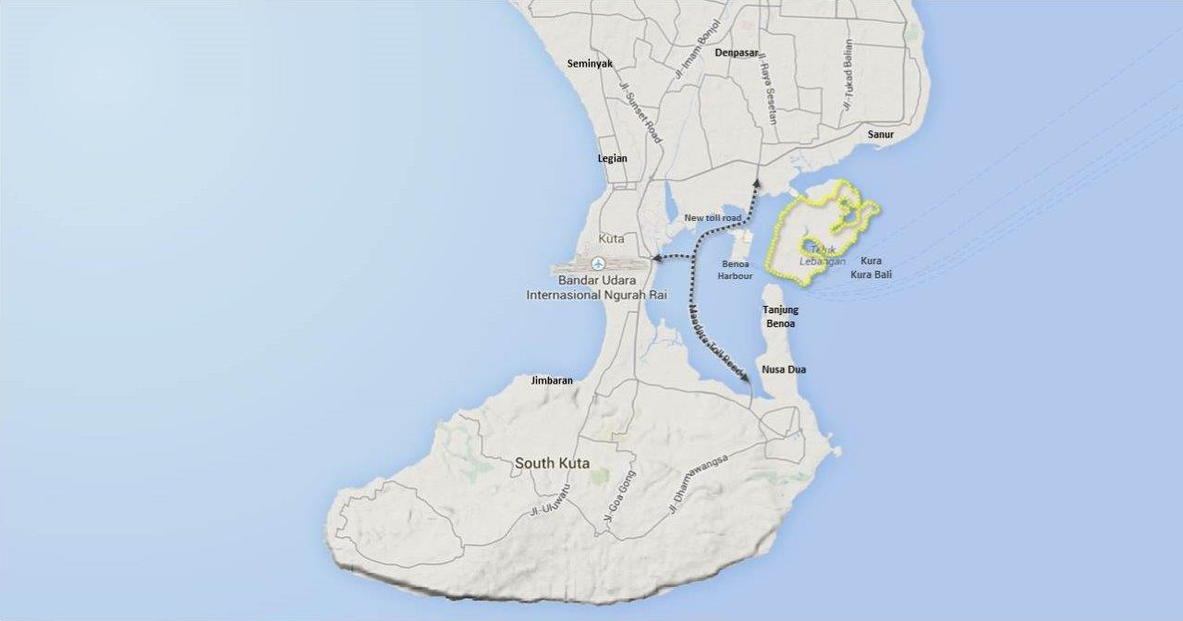


Kura Kura Bali
3
Location | Kura Kura Bali (KKB) Island is a 500 hectare island within a 10 minutes drive from Ngurah Rai International Airport and connected seamlessly to the main Bali island by a short bridge. Set against the dramatic backdrop of Bali’s sacred Mount Agung on the horizon, Kura Kura Bali is part of Bali’s capital city of Denpasar and easily accessible from other prime resort destinations such as Sanur, Nusa Dua, Jimbaran Bay, Kuta and Seminyak.
Description | Kura Kura Bali is a pioneering development based on the Balinese concept of Tri Hita Karana – Three Ways to Happiness – the harmony of Creation, Nature and Culture in all aspects of life. The unique eco development is an island with natural and cultural assets such 3,000 meters of coral reefs, more than 30 hectares of mangrove forest, turtle nestlings and existing Balinese temples. There were also about 600,000 trees planted by the master developer to turn the once sandy like island into a green oasis with more than 92 birds species. It is an Island of Happiness offering a sustainable ecosystem for a thriving international creative community. This unique eco development is designed around an integrated green masterplan with : 80 ha of green and mangroves 25 km of park connector 35km non-vehicular routes Green buildings Renewable energy for public lighting Storm water collection Car free zones
Services | Education & Technology Parks (UN SDSN and Tsinghua SEA Centre, Culture Tech Park, United In Diversity Campus, Industries (Finance, Health and Biotech, F&B, eco design and building , digital e commerce Data AI services etc), Marine Conservatory, Art & Culture (Traditional Village, Opera house, Q Music Park), Eco tourism (Fishermen Wharf, Marina, Bird Sanctuary, Adventure Park, Surf Resort), Wellness Centre, Creative Hub, and Services (Resort hotel & residence, retail & commercial & mixed development)
Phase One | Phase One covers 100 ha Infrastructure commence in 2019 Island will start operations in 2021
10 minutes drive from Bali Ngurah Rai International Airport
5 minutes drive from Benoa Harbour ( Bali’s main port)
15 min drive from Denpasar City (Capital of Bali) and major resorts of Sanur, Kuta, Legian, Seminyak and Nusa Dua
Denpasar (Capital of Bali)
Seminyak
6
Legian
Sanur
Kuta
Kura Kura Bali
Jimbaran
Nusa Dua
Prime Location
10 minutes drive from Bali International Airport
500 meters across from Benoa Harbour (Bali’s main port)
15-30 min drive from Denpasar
City and major resorts
2

Slide 3
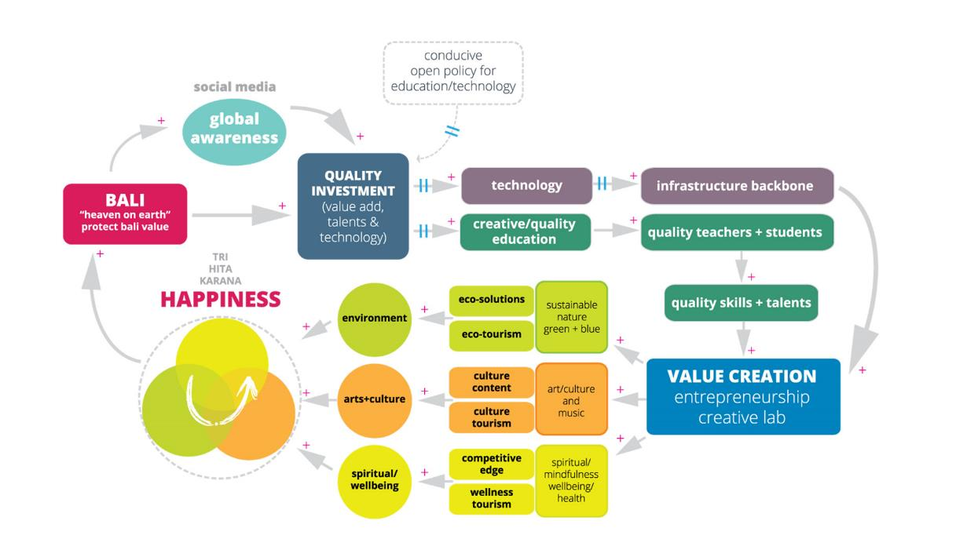
Kura Kura Bali

Slide 4
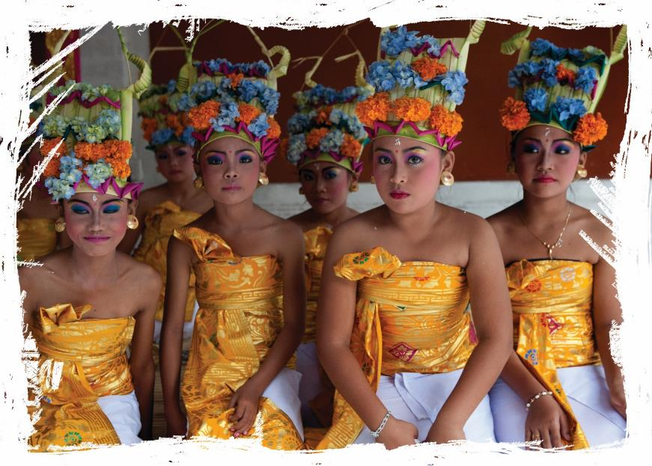

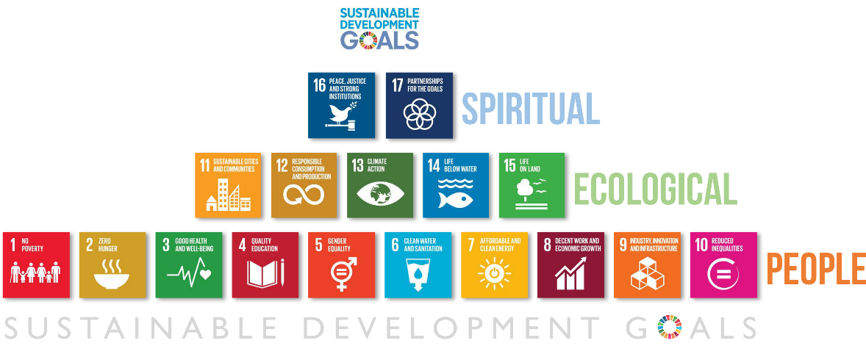
Kura Kura Bali
Three Ways to Happiness SDG PYRAMID – Tri Hita Karana
4

Slide 5












Kura Kura Bali
Infrastructure
Development of energy saving infrastructure including Smart grid
Compliment with fresh water and recycle management system
Modular design and new materials for infrastructure and facility development
Green energy source
Energy distribution & network management
EV public charger
Electric Vehicle
Integrated domestic battery wall
Big data and smart phone integration
Technology, Transport & Communication
Telecommunication broadband high-speed backbone
3D/ 4D modeling for developments
Mobile apps for services, management & operation
Augmented and virtual reality for information display and management
Self driven and eco transportation for both road and water
Water transportation with ferry services to connect with near by islands
80 HA
Green and mangroves
3000 m
Coral reef
25 km
Park connector
9 km
Tram network
38 km
Non-vehicular routes
95%
Population within 10 min walk to green transport
100% Building certified
green
100%
Renewable energy for public lighting
100%
Storm water collection
250 Ha
Car free zone

